Slide 1


Paris, Sophia Antipolis, London, San Jose USA

Slide 2

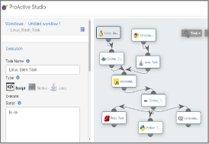
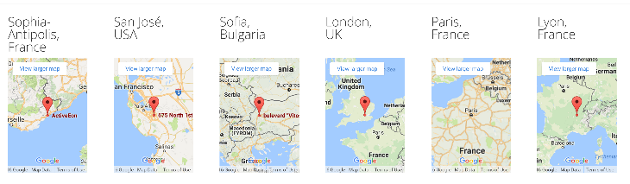
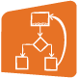
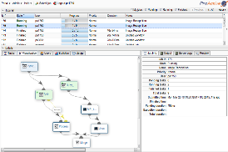






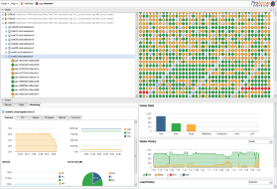



















Introduction
Locations
Products:
Workflows
& Parallelization
Some Customers
IT
Engineering
BioTech, Health
Finance, Media, IoT…
Scheduling & Orchestration
Resource Management

Slide 3
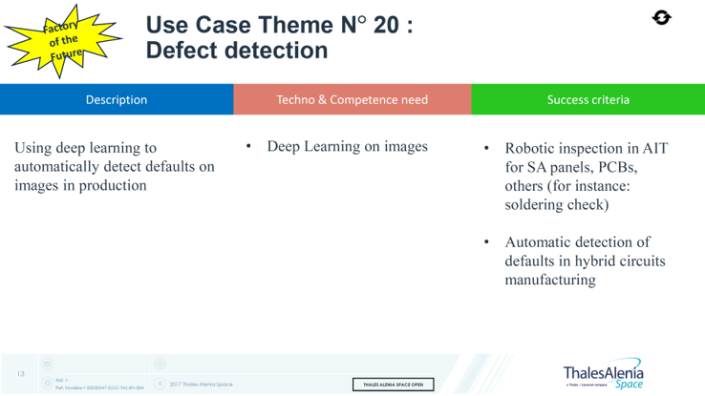
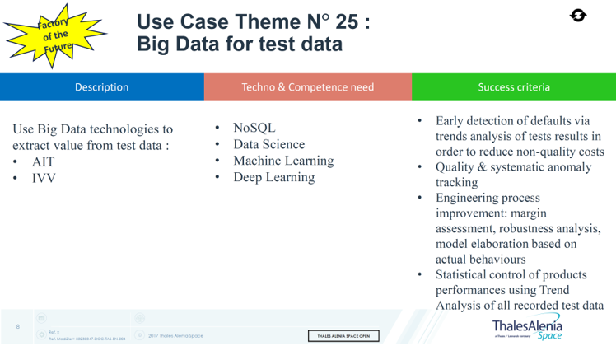
Use Cases Presented Today:
Default detection on Hybrid Circuits manufacturing with Deep Learning:
Focus on Wire defaults
Automatisation de scenarios d'analyse de données de Tests:
Vérification de télémétries de service

Slide 4
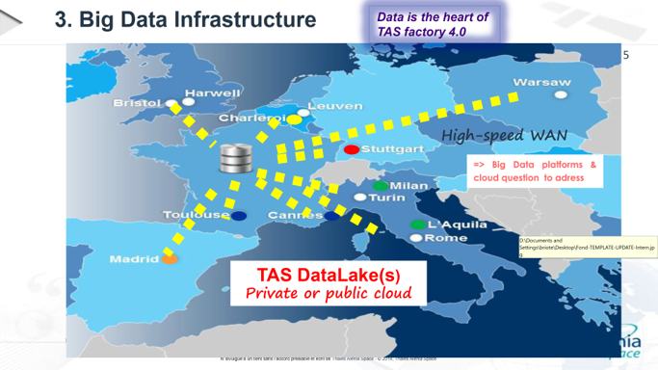
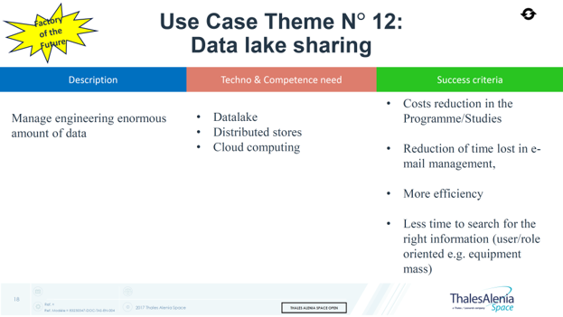
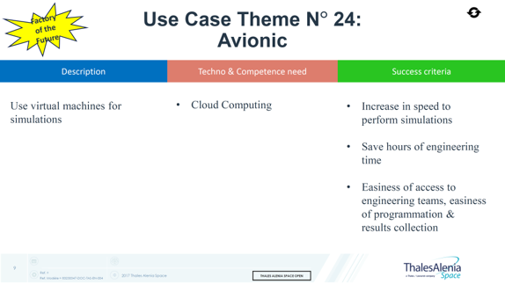
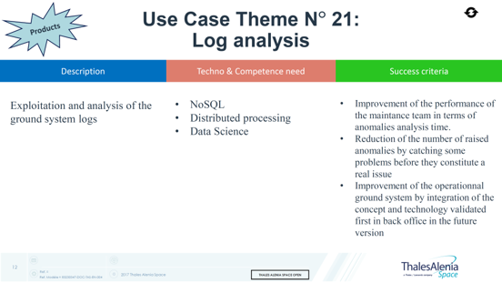
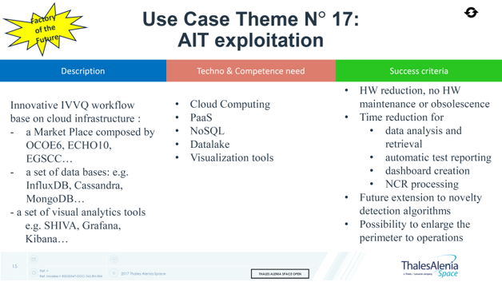
Other Potential Use Cases addressed with AE Technology

Slide 5
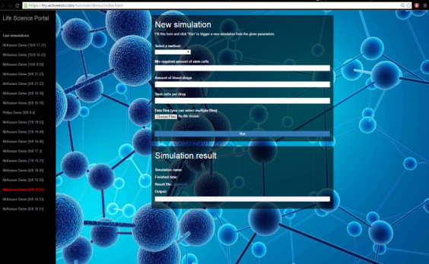
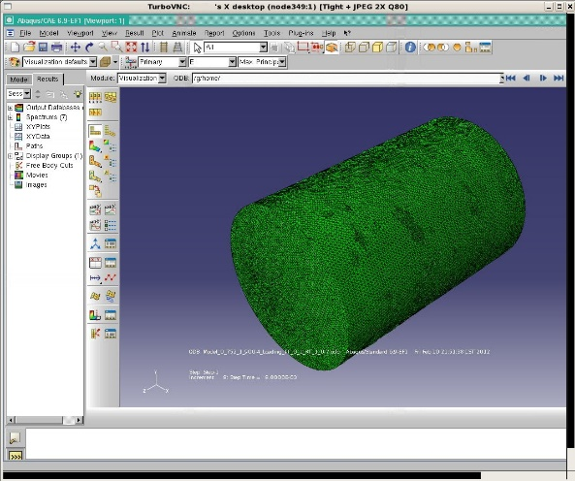

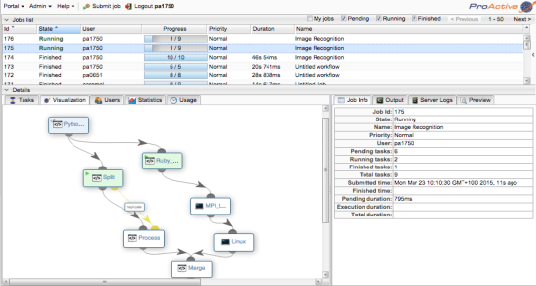
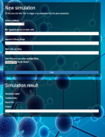












ActiveEon Solution: Data Analysis for Everyone
</>
Application-specific Interfaces
Integrated Web Portals
Remote Visualization
API
ProActive Workflows
Fault Tolerance
Cloud bursting
Resource agnostic
Micro-service
Scheduler
Resource Manager
LSF
Clusters

Slide 6
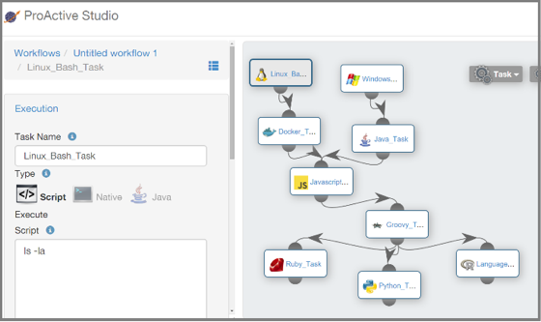

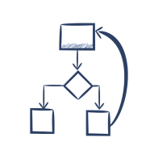
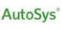




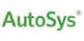








Business Workflows
Processing & Data Automation Workflows
Any
Language
Secured Data Transfers
Third-part
Schedulers
Market ETL, ERP...
Services Chaining
& Integration
Translator
Scheduler
& Orchestration
</>
Open REST API
Priority & Planning
Parallel Executions
Error Management
Multi
Users
Resource Management & Monitoring
Multi Platforms
Local machine
Network
Resources
Batch Schedulers
Clouds
Slurm
PBS
SGE
LSF

Slide 7
Some Customer Cases

Slide 8

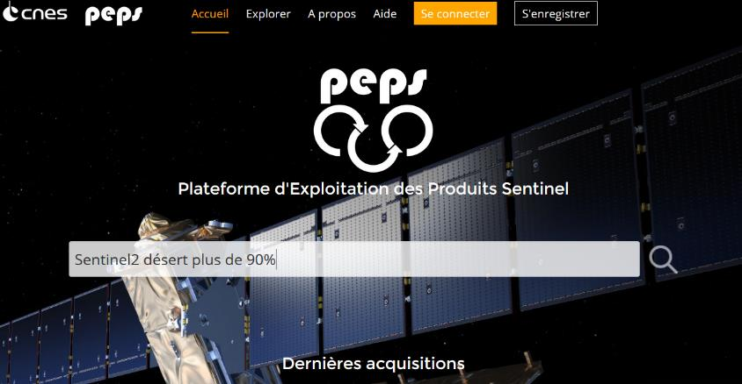

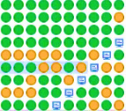

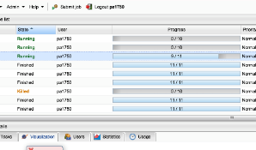
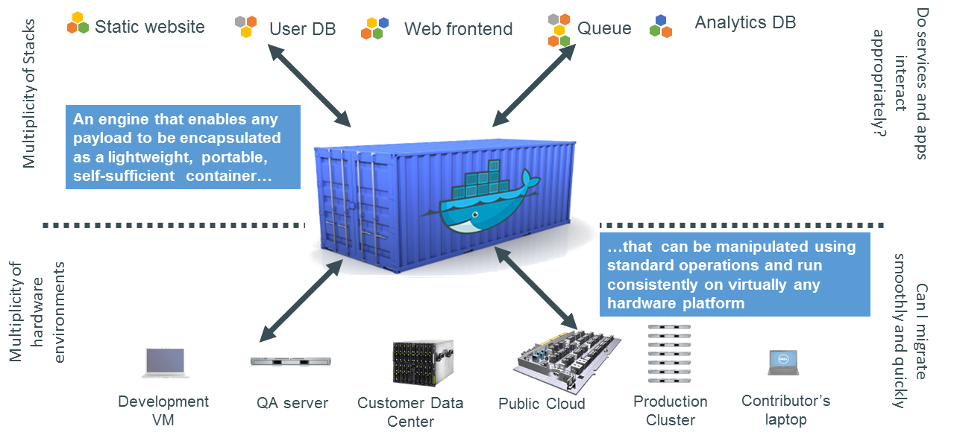

PEPS: Sentinel Satellite Image Analysis
ProActive nodes
ProActive task

Slide 9



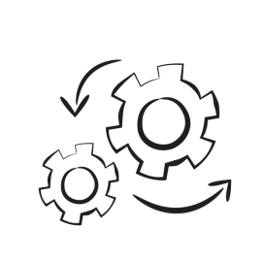



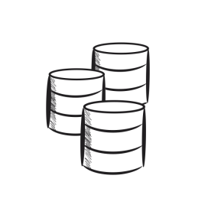

Meta-Scheduler, Big Data ETL + new ELT
Main Benefits
Central Orchestration Tool
Workflow Expressiveness: universal & comprehensive
Management of Security for highly sensitive environments
Management of Resources for all appliances (SAS, GREENPLUM, …)
Execution prod
Analytical prod
Staging
Dev
Virtualized Infrastructure using Docker 4 000 Thousands of physical cores

Slide 10




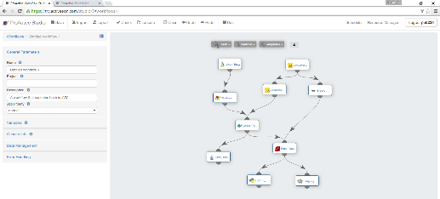


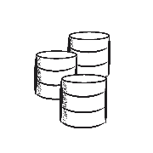

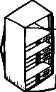

IoT Automation in the Cloud
Schedule data analytics
hourly or on events
Real-Time Control & Optimizations
Data from Mining Machine Sensors
Data
Data Processing
on Premises and in
Health and performance of machines

Slide 11


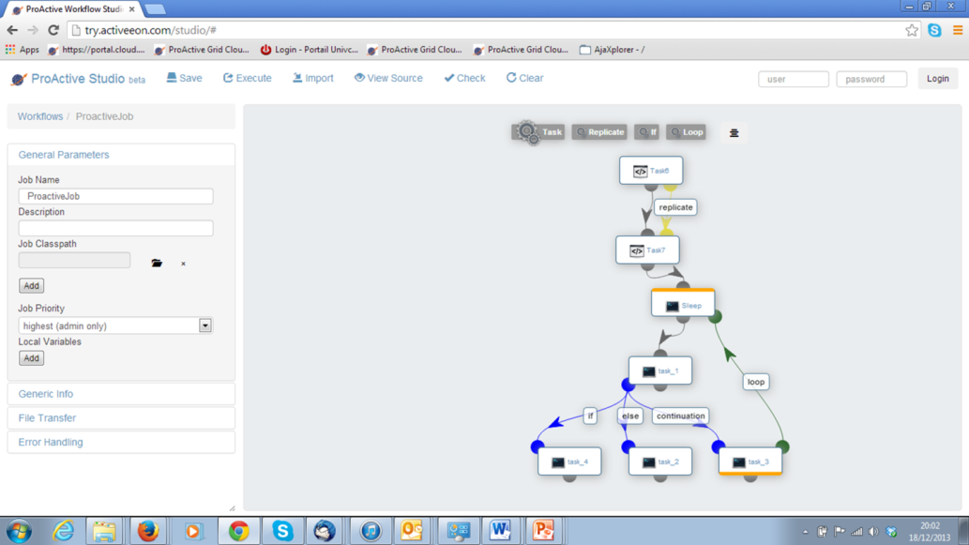

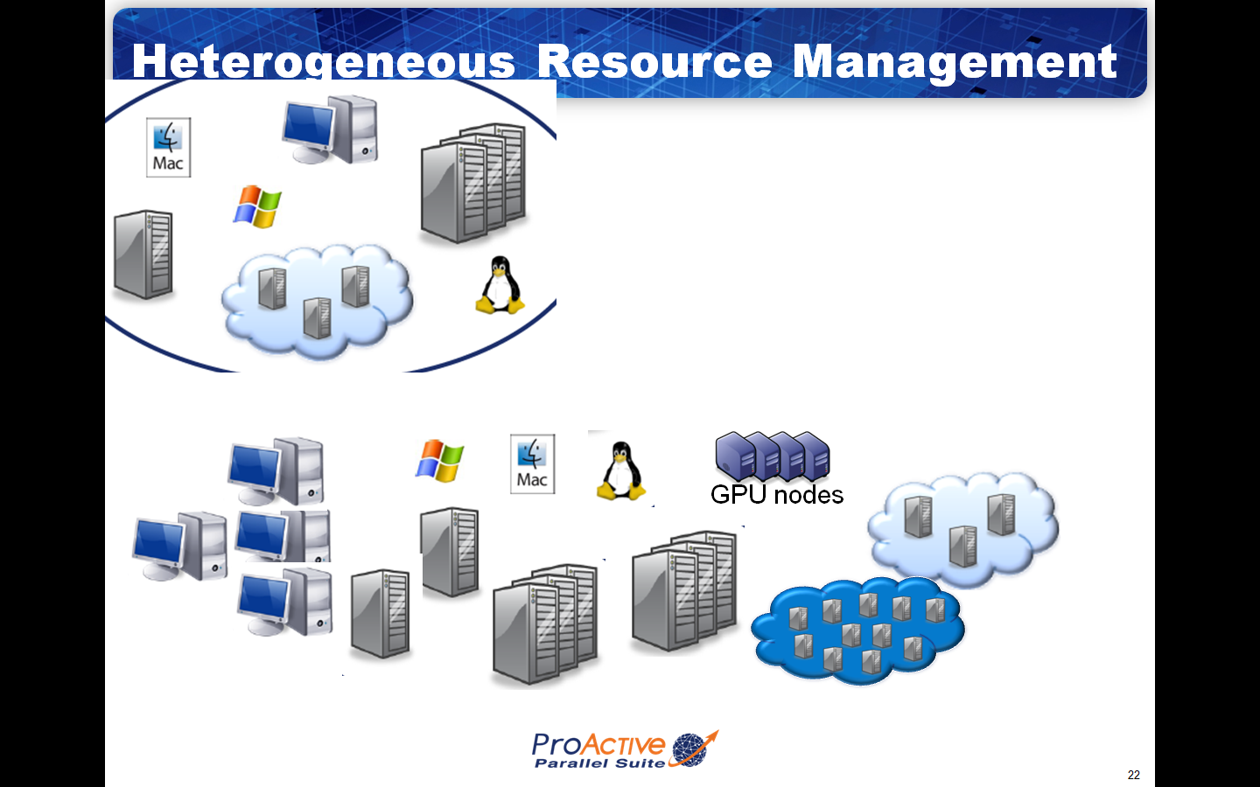

Platform for Cosmetic Formulation for 2000 persons around the world and for Innovation Team. (Statistic, Machine Learning, Use of Language R)
2 000 persons
around the World
Private Network + HTTPS
Monitoring
Workflows
Orchestration
Innovation Team (Statistics, ML, R)
Data
Data
Mining
Compute

Slide 12



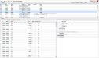


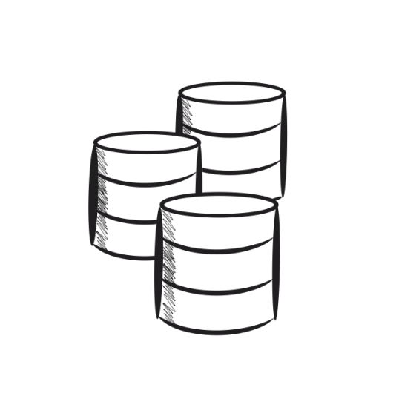
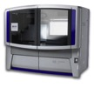


Large Scale Data Analysis
Quantitative Metagenomics Platform for gene profiling and statistical analysis
Why // DB + ActiveEon:
Pre, Post Processing of Data Analysis.
Flexibility, Speed of Analysis with ActiveEon.
Finer Grain & Faster
Scheduler Web Portal
Domain-specific Users
HTTPS
REST / HTTPS
SSL
SSL
SSL
1TB / Sequence Analysis
40TB
Windows Cluster 1
192 cores
Linux
Cluster 2
366 cores
Total
DNA
QC/Library preparation
SoLiD/Illumina
Sequencing
Parallel DataBase

Slide 13

First Use Case:
Default detection on Hybrid Circuits manufacturing with Deep Learning:
Focus on Wire defaults

Slide 14
Contents
1. Introduction
2. Key Challenges
3. Proposed Approach
4. Workflows
5. Demonstration
6. Experiment Results
7. Future Works

Slide 15
Examples of Image Received
Put here about 12 to 15 representative images received (with wired).
Those images are identified as potentially bad by TAS current ML.
The Objectives: reduce the number of Fault Positive and ease operator verification

Slide 16

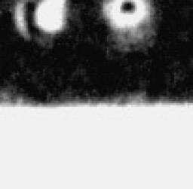

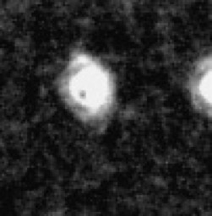
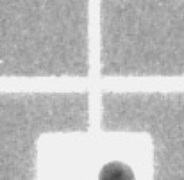
Cleaning the Data Set
Number of images
Original data set size: 4030 images.
Number of images containing wires: 975 images.
Examples of images from the original data sets.

Slide 17
Key Challenges Tackled
1. How to effectively detect the wires in the image?
Occlusion, variation of illumination, noise, etc.
Grayscale image
Semantic analysis
2. How to analyze wires separately ?
Images have multiple wires
3. Which method to use to detect defects in wires?
Only false positive samples

Slide 18
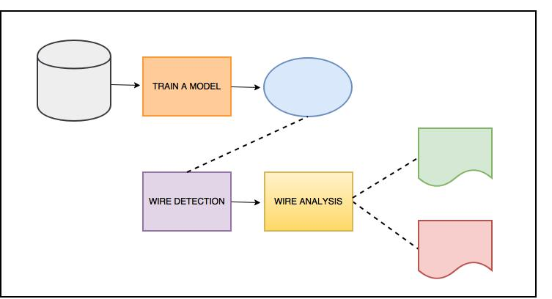
Approach
IMAGE
DATA SET
MODEL
GOOD
All the False Positives from TAS current ML Analysis
OR
Directly the images coming from the Production Lines
BAD
Our proposed approach.

Slide 19
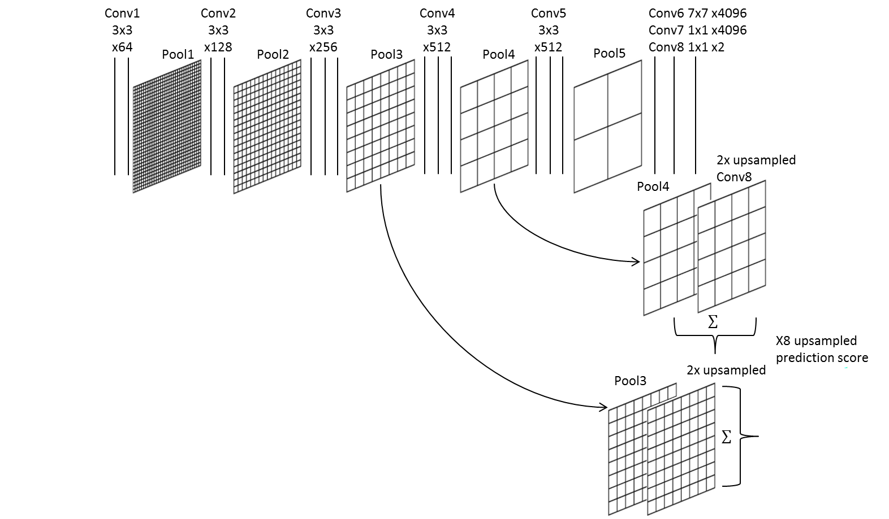
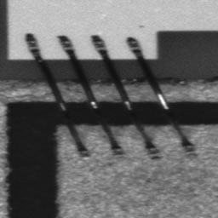

Approach
Use Deep Learning to detect the wires from the input images.
Main advantages
Reduces the need for Feature Engineering, one of the most time-consuming steps of machine learning practice.
It can handle different types of image challenges, for instance occlusion, variation of illumination, noise, etc.
It considers the semantic context

Slide 20
Proposed Approach
Perform wire analysis: compute statistics for labeled regions to separate the detected wires.
Input image
Multiple wire segments
Individual wire segments
Segment analysis

Slide 21
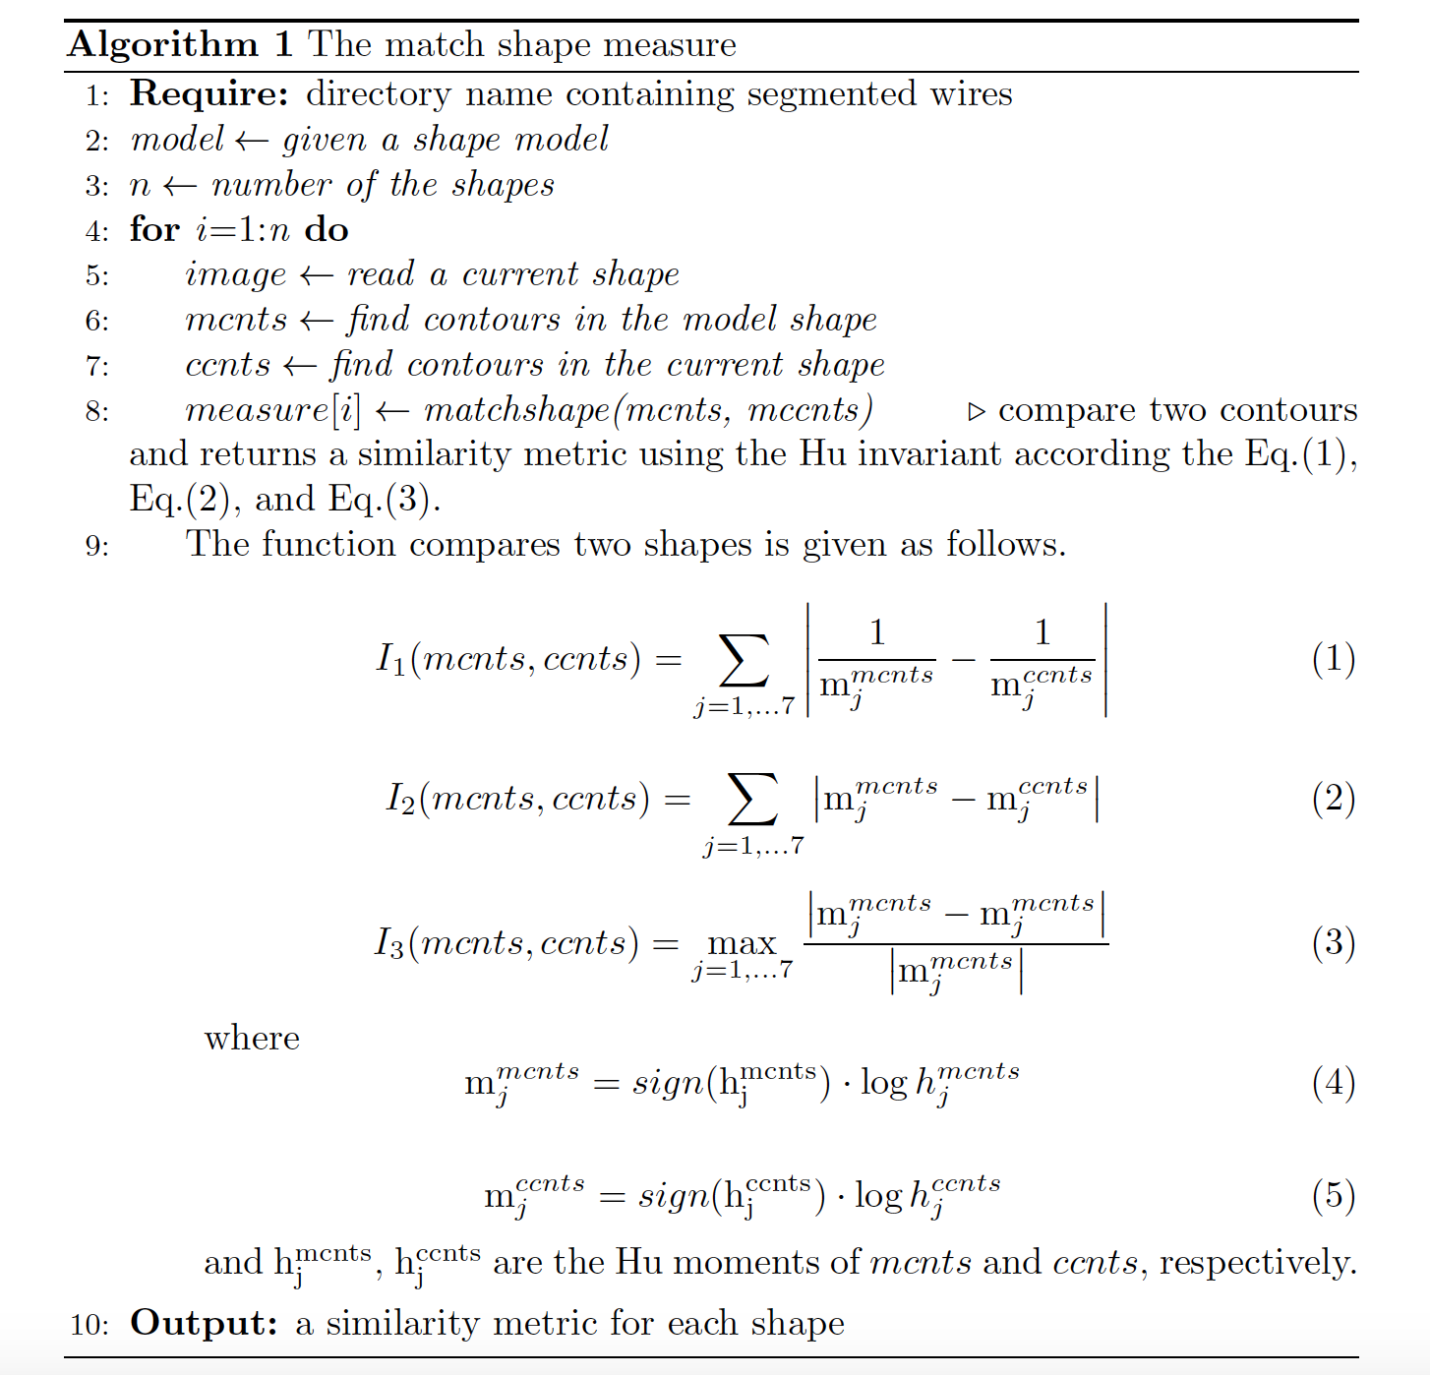
Approach
Defect detection: use a pre-defined wire model and compute a distance measure.
This approach is invariant to translation, rotation and scale

Slide 22
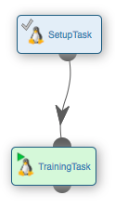
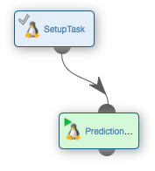
Workflows and Tasks
Workflow for training
Workflow for prediction
Strong Benefits:
Accelerate with Parallel execution
Short Release Cycle, Easy to deploy
Easily accessible in Corporate, Distributed context (Use Case No12)
Building Blocks to be extended, used for other applications

Slide 23
Workflows
Demonstration

Slide 24
Workflows
Video

Slide 25
Experimental Results
Examples of the Output
Thanks to put here :
8 to 10 images identified as Good
2 Images identified as potentially Bad
(Resut Images with the Wired in Green and Red)

Slide 26
Experimental Results
Experimental Setting Total images: 300 images (Identified as Bad by current TAS Analysis
Subset for training: 126 images
Over the 300 Images,
the proposed approached correctly identify as good 291 Images,
and keep only 8 for the Operator to verify
The tool can be used after the current TAS analysis (to eliminate most of False Positives), or directly on the images coming from the Production Lines

Slide 27
Experimental Results
Running time: GPU vs. CPU
Steps | Running time (GPU) | Running time (CPU)
Training (126 images) | ~5min | ~40min
Prediction (975 images) | - - - - - - - - | ~30min

Slide 28
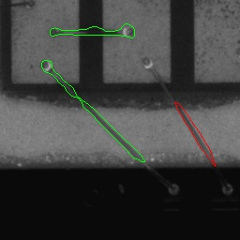
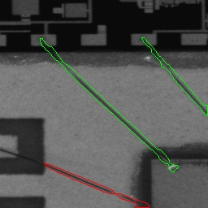
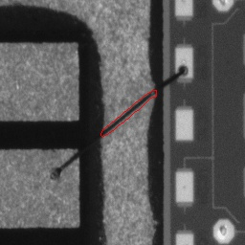
Future Works
Improvements for the proposed approach
Train our deep neural network with more images
Ideal use case: 50% of 975 images for training, 25% for validation and 25% for testing.
Examples of bad wire segmentation.

Slide 29
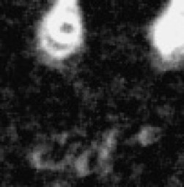
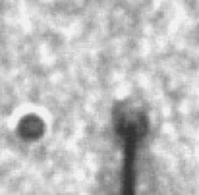
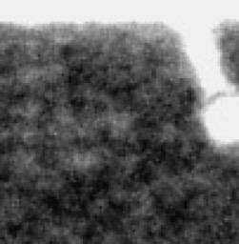
Future Works
Improvements for the proposed approach
Other color space images such as RGB, multispectral, and depth information.
Same perspective for all images (zoom, scale, …).
Examples of images from the original data set.

Slide 30
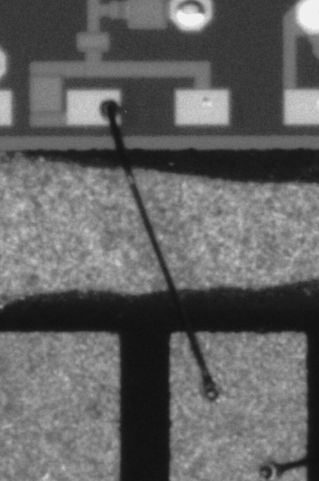







Experimental Results
Why we did not use the 975 images?
We need to create, manually, ground truth data for training
C111-1_BOND_2046.jpg
C111-1_BOND_2046.jpg
C351-1_BOND_2006.jpg
C351-1_BOND_2006.jpg
C331-1_BOND_2019.jpg
C331-1_BOND_2019.jpg
ZH06-1_BOND_2003.jpg
ZH06-1_BOND_2003.jpg
50% of 975 images for training, 25% for validation and 25% for testing

Slide 31
Experimental Results
Experimental Setting Total images: 300 images (Identified as Bad by current TAS Analysis
Subset for training: 126 images
I do not understand: Bad #Image decrease while Accuracy arise ??
And I believe it is better not to enter in those details.
Threshold analysis | Good images | Potentially Bad images | Accuracy
0.05 | 114 | 185 | 38 %
0.09 | 224 | 75 | 75 %
0.10 | 260 | 39 | 87 %
0.15 | 286 | 13 | 95 %
0.25 | 291 | 8 | 97 %

Slide 32
Second Use Case
Automatisation de scenarios d'analyse de données de Tests:
Vérification de télémétries de service

Slide 33
PoC UC 25, Big Data for test data: Automatisation de scenarios d'analyse de données de Tests
L'objectif de ce PoC est de tester et valider l'automatisation de scenarios d'analyse de données de Tests. Ces procédures sont à automatiser car elles devraient être faites entièrement sur toutes les données à chaque test, alors qu'actuellement elles ne peuvent être réalisées que très ponctuellement sur un ensemble très restreints de données. Cette automatisation sera réalisée par une sur-couche au système actuel, sans modifier celui-ci, à l'aide des outils de Workflows Big Data de la solution ActiveEon. Les ressources utilisées pour executer ces procédures seront celles existantes chez TAS: des machines physiques locales, des clusters existants, virtualisés ou non, etc.
Il existe actuellement 6 scenarios:
1- Comparer toutes les données d'un test à celles de référence
2- Montrer à un instant T toutes les données qui ont bougées depuis un Temps X
Prévision de la gravité de l'évotlution de l'incident dans le future.
3- Vérification de télémétries de service
4- TM Frequency Verication.
5- Evolution des Sequences Counters
Check + 1 à chaque packet. 20 fonctions dans le logiciel, chacune ayant un compteurs.
6- Verification du protol 1553: conforme specification officielle, conforme aux principes de plus haut niveau de Thales.
Les données de Test sont actuellement disponibles sous forme de fichiers, et dans une BD (Lucile au dessus Oracle) avec Librairie Dcom.
Le PoC sera a priori organisé selon la planning suivant:
1- Analyse de l'existant (2 Jours)
2- Analyse des 6 scenarions et Proposition d'Architecture (pour les données et les six scenario) (2 Jours)
3- Discussion Validation avec TAS, Choix de l'Architecture, Choix des Scenarios à Implémenter (1 Jour)
4- Installation du logiciel ProActive Workflows & Scheduling, Implementation des scenarios choisis en 3. (15 Jours)
ActiveEon fournira le logiciel ProActive Workflows & Scheduling avec 2 mois de support pour test et validation par TAS.
Date de démarrage envisagée du PoC: mai.

Slide 34
Vérification de télémétries de service
Motivation
Test Data are growing very fast. It is needed to achieve more and more Verifications and Validations
Workflow will permit to accelerate treatments and permit analysis that were not possible before
It will also permit to fetch and push data from many sources, and to execute tests on many locations

Slide 35



Vérification de télémétries de service
Principal Ideas:
Data Parsing
Data Analysis
Data Display
1. Check TM HW packet
2. Check TM packet number
3. Check TM packet order and type

Slide 36
Vérification de télémétries de service
ProActive Workflow:
The replication task enables to parse many pairs of (TC packets, TM packets) data from many locations.
Telemetries verification are executed in parallel addressing three tests:
1- Check that all TM packets are software
2-Check that TM packet are of correct number regarding the TC packet sent.
3-Check also that TM packets are of good sub service type and well ordered
Verification results are displayed in HTML format where wrong data in TC/TM data are highlighted.

Slide 37
Workflows
Demonstration

Slide 39
Paris, Sophia Antipolis, London, San Jose USA

